Slide 1

Predicting customer buying behaviour
14/07/2023

Slide 2
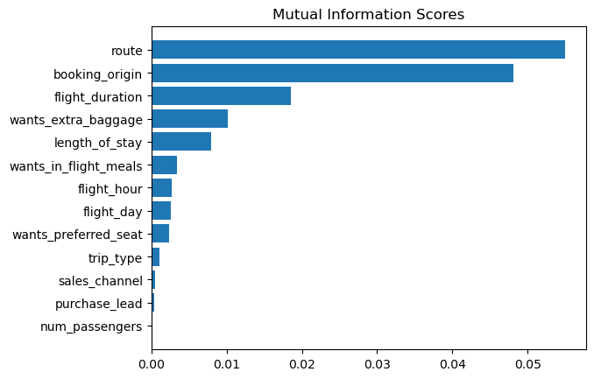
predictive model to understand factors that influence buying behaviour
From the results we can infer that
1. Route
2. Booking Origin
3. Flight Duration
4. Wants Extra Baggage
5. Length of Stay
are the top 5 features which influence
customer buying behavior

Slide 3
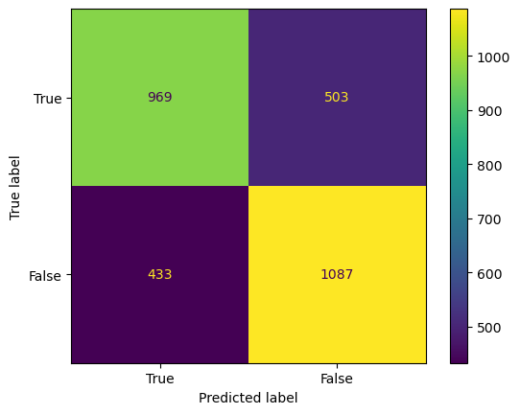
predictive model to understand factors that influence buying behaviour
Based on the different model experiments carried out, Random Forest with hyperparameters tunned using RandomisedSearchCV
n_estimators: 120, max_samples: 0.5, max_features: 1.0, max_depth: 10
gave the best results using RandomisedSearchCV
1. Accuracy: 68.71%
2. Precision: 0.688
3. Recall: 0.659
4. F1 Score: 0.673
5. ROC AUC: 68.67%

